Slide 1
CONTENT
Abstract
Introduction
Problem Statement
Block Diagram
Components
Components Description
Hardware kit
Result
Reference

Slide 2
ABSTRACT
The smart vehicle event data recorder using IoT aims to improve road safety and emergency management. A combination of sensors such as IMU, GPS, alcohol, ultrasonic, fire and temperature sensors were integrated to detect key driving events and battery condition.
The system was built to collect and transmit real-time data using an IoT module, with an SOS button and buzzer enabling quick alerts during emergencies. Controlled by an Arduino, this setup was intended to support accident detection, driver monitoring, and immediate communication with emergency services, ultimately enhancing vehicle intelligence and post-incident analysis.

Slide 3
INTRODUCTION
With the rise of electric and autonomous vehicles, the need for systems that monitor driving behavior and detect critical events became increasingly important. To address this, a smart vehicle event data recorder using IoT is designed as safety solution.
This system was intended to collect real-time data, detect accidents, and notify emergency services instantly, contributing to safer and more responsive transportation.

Slide 4
PROBLEM STATEMENT
It was observed that current electric vehicles lacked a reliable system to monitor and record critical road events such as sudden impacts, unsafe driving, or collisions. This limitation made it difficult to analyze incidents accurately and caused delays in emergency response.
The need for a more responsive and intelligent system was identified to enhance safety and provide real-time alerts.

Slide 5
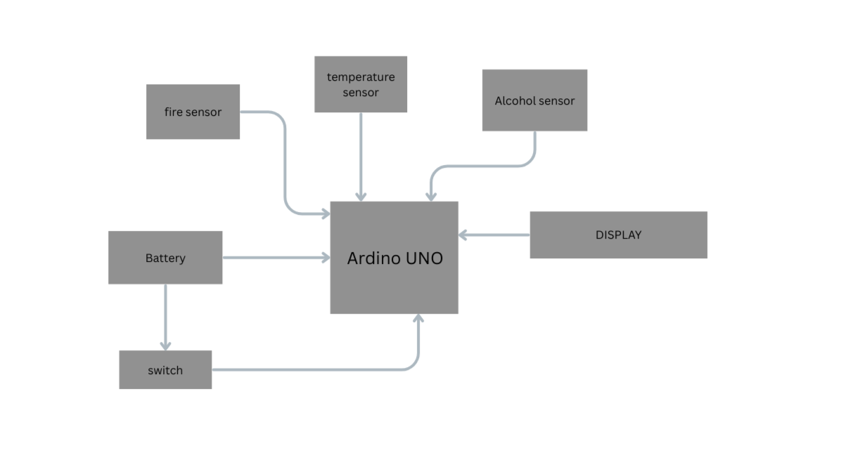
BLOCK DIAGRAM

Slide 6
COMPONENTS
Arduino uno
Alcohol Sensor
Fire Sensor
Power Supply 5v
Temperature Sensor
IOT

Slide 7
COMPONENT DESCRIPTION
Arduino Uno: A microcontroller board that acts as the brain of the system, controlling all connected sensors and modules.
Alcohol Sensor: Detects alcohol concentration in the air to identify intoxication levels.
Fire Sensor: Senses flame or fire presence using infrared light detection.
Power Supply 5V: Provides regulated 5V power to the Arduino and other modules.
Temperature Sensor: Monitors ambient temperature for safety or control purposes.
IoT Module: Enables wireless data transfer and remote monitoring through the internet.

Slide 8
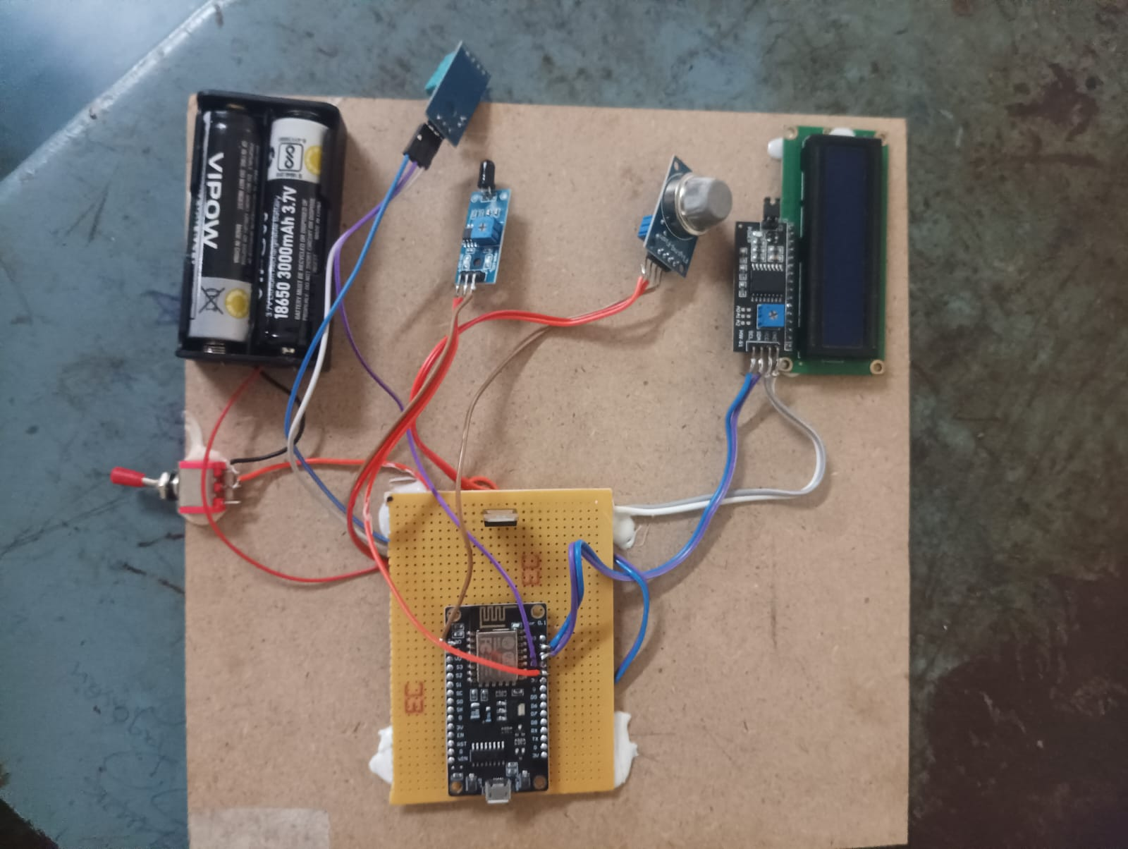
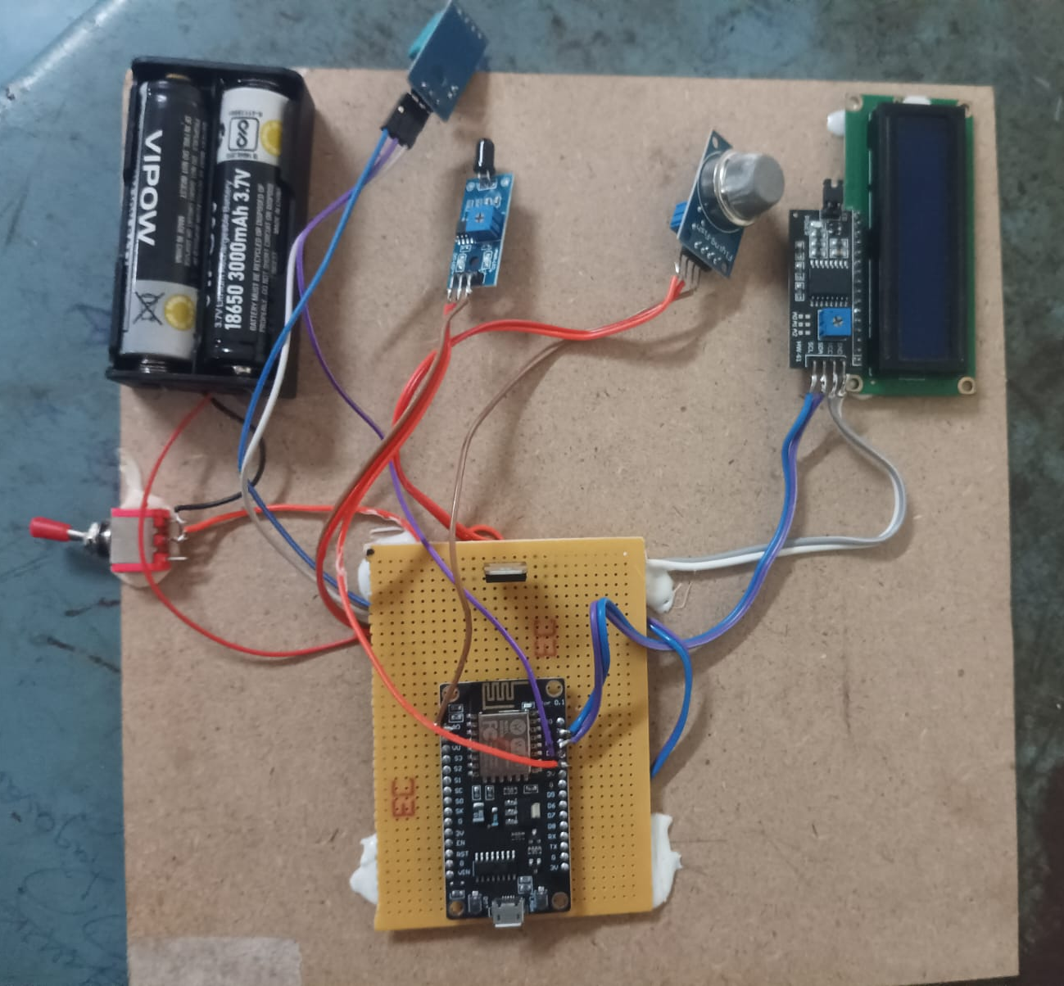
HARDWARE KIT

Slide 9
RESULT
The Smart EV vehicle uses an alcohol sensor to detect if the driver has been drinking, preventing the vehicle from starting to avoid accidents caused by drunk driving. It also includes a battery heat sensor that monitors the temperature to prevent overheating, helping protect the battery from damage. If the battery gets too hot, the system sends an alert to the driver for quick action. These safety features ensure that the vehicle operates only under safe conditions. By combining these sensors, the Smart EV improves overall driving safety and battery lifespan. This technology can reduce accidents and increase driver confidence. It offers a practical solution for safer, more reliable electric vehicles. Ultimately, this system promotes responsible driving and protects both people and the vehicle’s components.

Slide 10
REFERENCES
“IoT-Powered Emergency Vehicle System: Rapid Accident Response in Cities – E. V. Ciji, A. Xavier, A. A. Hussain, D. Soman, J. Joy, and D. George, International Journal of Progressive Research in Science and Engineering, vol. 5, no. 5, pp. 88–92, 2024.
An IoT Based Accident Detection and Rescue System – V. V. Anusuy, B. Jasmith, P. Sugasini, and M. J. Dharshini, International Research Journal on Advanced Engineering and Management, vol. 1, no. 1, pp. 10–15, 2023.

Slide 11
CONCLUSION
    The Smart Vehicle Fire Prevention and Monitoring System effectively enhances passenger and vehicle safety through real-time temperature tracking and early fire detection.
    By integrating an alcohol detection module, the system helps prevent accidents caused by drunk driving.
    Its combination of sensors and automated alerts ensures quick response to potential hazards.
    Overall, the system improves reliability, safety, and user confidence in modern vehicles.
    This solution demonstrates how smart technologies can significantly reduce risks and promote safer transportation.

